Slide 1
Creating a multiple linear regression model to predict total cinema ticket sales
Jordan Tompkins
Western Governors University, D214

Slide 2
Introduction – Jordan Tompkins
Education:
Saint Michael’s College, Colchester, Vermont
Class of 2021, BS in both Statistics and Accounting
Professional:
Audit Senior Staff, Crowe LLP

Slide 3
Context
The cinema industry is one of the largest industries in the world today.
While they are in the process of showing movies to customers, they are also a business and need to make a profit to stay afloat

Slide 4
Problem and Hypothesis
Research question: Can a statistically significant multiple linear regression model be created to predict total sales?
Null Hypothesis: The selected features will not be able to create a statistically significant model to predict total sales in the dataset and will have a p-value greater than 0.05
Alternative Hypothesis: The selected features will be able to create a statistically significant model to predict total sales and will have a p-value less than or equal to 0.05

Slide 5
Data-Analysis Process: Data Collection
The first step of the data analysis process was to collect the data
Data was obtained from Kaggle.com from a user who goes by the handle Mobius.
Data contained 14 variables (columns) and 145,525 rows
Contains information such as total sales, total amount of tickets sold, ticket price, etc.

Slide 6
Data Analysis Process cont: Data Extraction and Preparation
The chosen tool for the data analysis was Python
Performed basic EDA on the data
Checked for nulls, outliers and duplicated values
Dropped unnecessary columns (film and cinema codes, and date variable)
Filled null values in and dropped duplicates
Checked both univariate and bivariate distributions

Slide 7
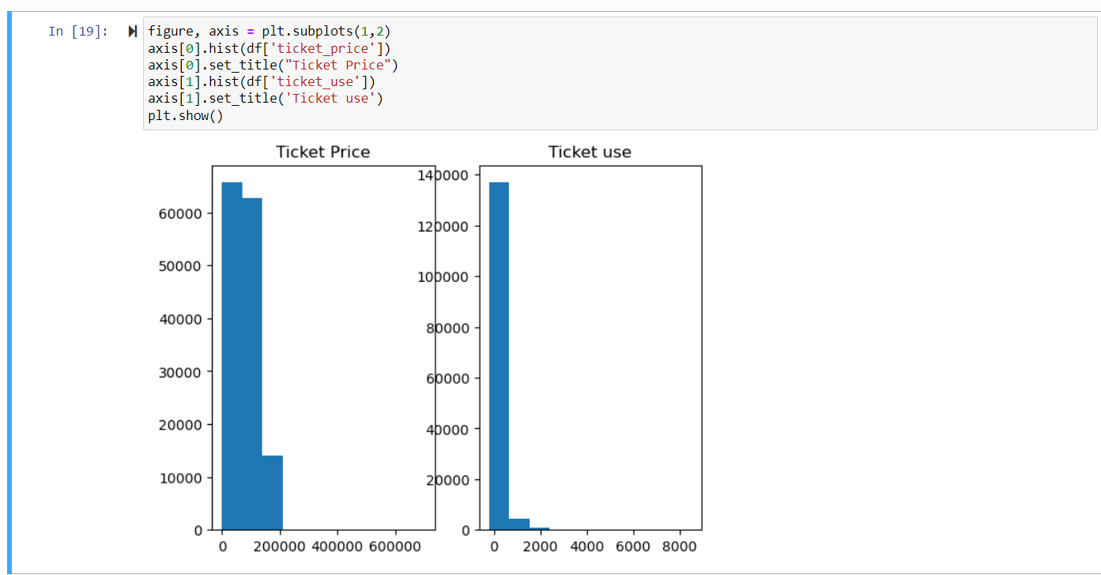
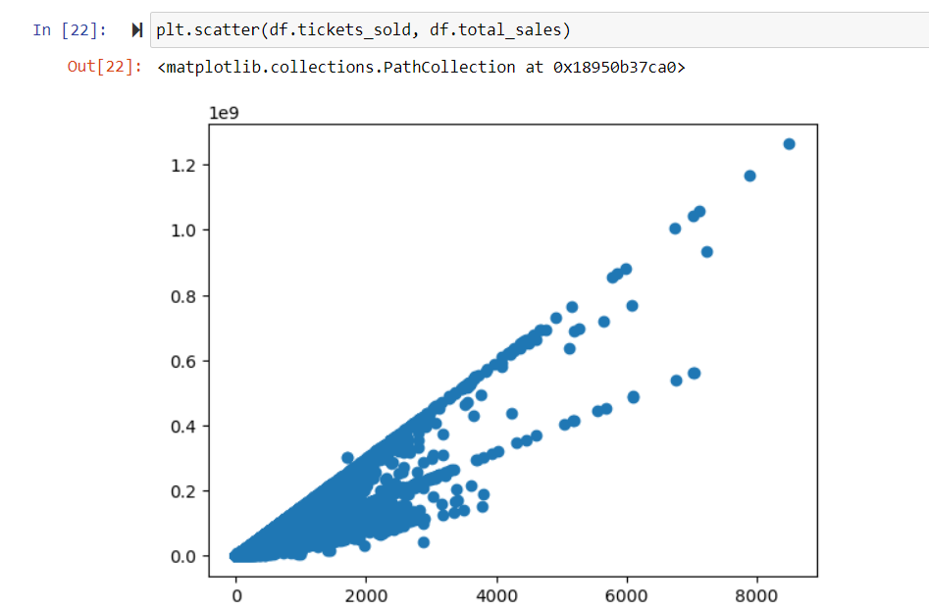
Univariate and Bivariate Distributions
Univariate
Bivariate

Slide 8
Data Analysis Process cont: Analysis
Checked variance inflation factors for the variables to measure multicollinearity within variables for the model
Checked correlations using a heatmap to help determine what variables will be used in the model
Created an initial model with all variables
Performed Backwards Stepwise Elimination to reduce the model, eliminating any variables with a p-value greater than 0.05

Slide 9
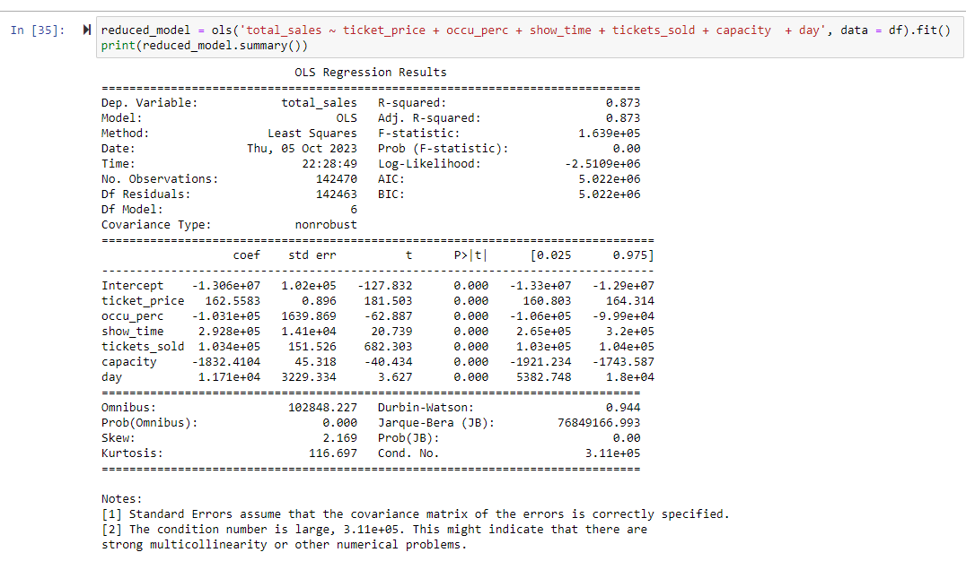
Findings
A reduced model was created with no variables that had a p-value greater than 0.05
Prob (F-statistic) of reduced model was 0.00
R-Squared value of 0.873, which means that 87% of the variation in the dependent variable (total_sales) is explained by the independent variables

Slide 10
Limitations
One limitation with the data is that the data only covers the year 2018. While there are a ton of observations, many other factors could have an impact on ticket sales
Multiple linear regression is sensitive to outliers. Without proper cleaning and preparation, the regression model created could be impacted in an unfavorable way

Slide 11
Proposed actions
Get more data. Instead of using only one years worth of data, the use of multiple years worth of data can be beneficial
Expand on the features explored to include different variables. For example, was it a sequel to a box office hit, was it in a large franchise, etc.
Compare the prediction results to actual results to truly get a better understanding of if the company is making what they theoretically should make.

Slide 12
Expected benefits
Theaters can compare how well they did versus how well the model predicted they should do
Theaters also know what variables impact total sales and can use it to determine ways to improve their business by focusing efforts on significant variables

Slide 13
Sources
Flom, P. (2019, March 2). The disadvantages of linear regression. Sciencing. Retrieved March 4, 2023, from https://sciencing.com/disadvantages-linear-regression-8562780.html
Mobius. (2020, October 29). Cinema tickets. Kaggle. https://www.kaggle.com/datasets/arashnic/cinema-ticket

